Slide 1

Introduction to Supervised Machine Learning
Jayanth Rasamsetti
Co-founder & Chief Scientist
www.sgmoid.com
Columbia University (MS)
IIT Madras (B.Tech & M.Tech)

Slide 2
Agenda: (Day 1 - Session 1)
Machine Learning and types
Introduction to Supervised Learning, Unsupervised Learning
Correlation & Regression
Case Study 1 - MT Cars; OLS, Sklearn
Residuals
Normal QQ Plot
Agenda: (Day 1 - Session 2)
Scale - Location Plot
Residuals vs Leverage Plot
VIF (Multicollinearity), Outliers

Slide 3

Best Practices:
We will be very hands on! Blend of theory & lab
Very important to code every day 20 lines of Python code
Introduction to Google Colab (https://colab.research.google.com/notebook)
De-bug as much as possible every line of code
20 min rule: Try to debug for 20 min independently (either stack overflow, etc) and only then seek help (from a peer)
Tips to improve coding: Pair programming, long hours, competitions
Avoid copy pasting!

Slide 4
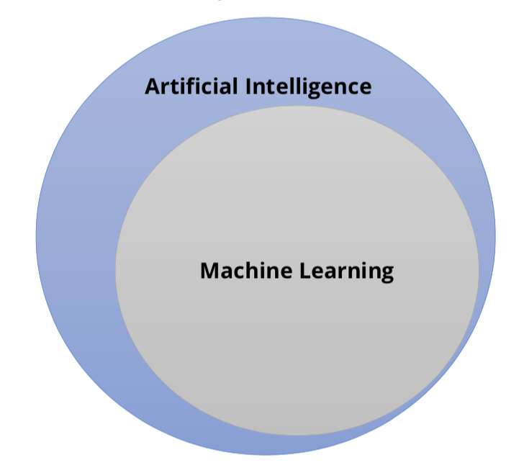
Definition of Machine Learning
The capability of Artificial Intelligence systems to learn by extracting patterns from data is known as Machine Learning
Relationship between Artificial Intelligence and Machine Learning
Machine Learning is an approach or subset of Artificial Intelligence that is based on the idea that machines can be given access to data along with the ability to learn from it.

Slide 5
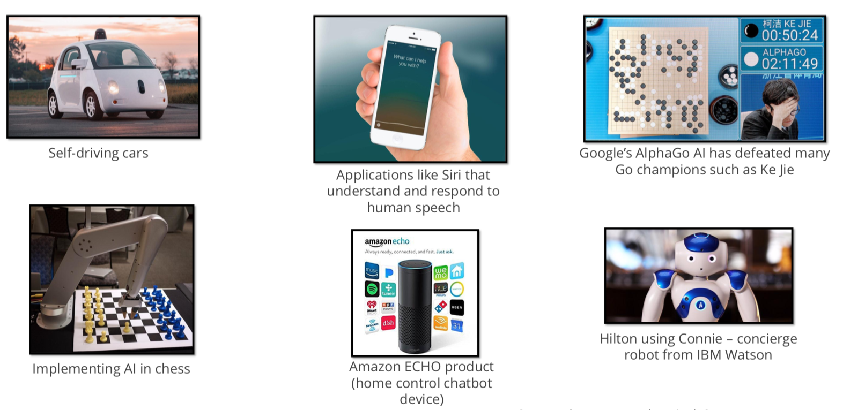
Applications of Machine Learning:
https://www.youtube.com/watch?v=LLP9ce5cbZY

Slide 6
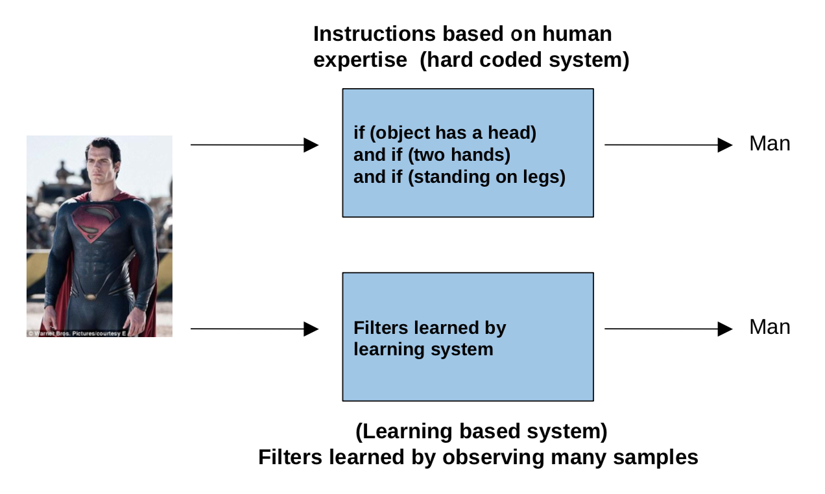
Traditional Programming vs. Machine Learning:

Slide 7
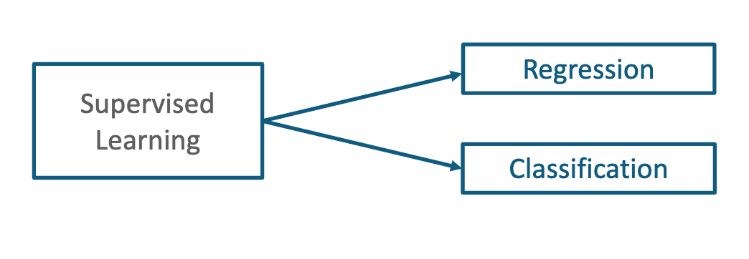
Types of Machine Learning:
Supervised
Unsupervised

Slide 8

Supervised Learning (Case Study):
Ever wondered how Amazon makes recommendations?

Slide 9
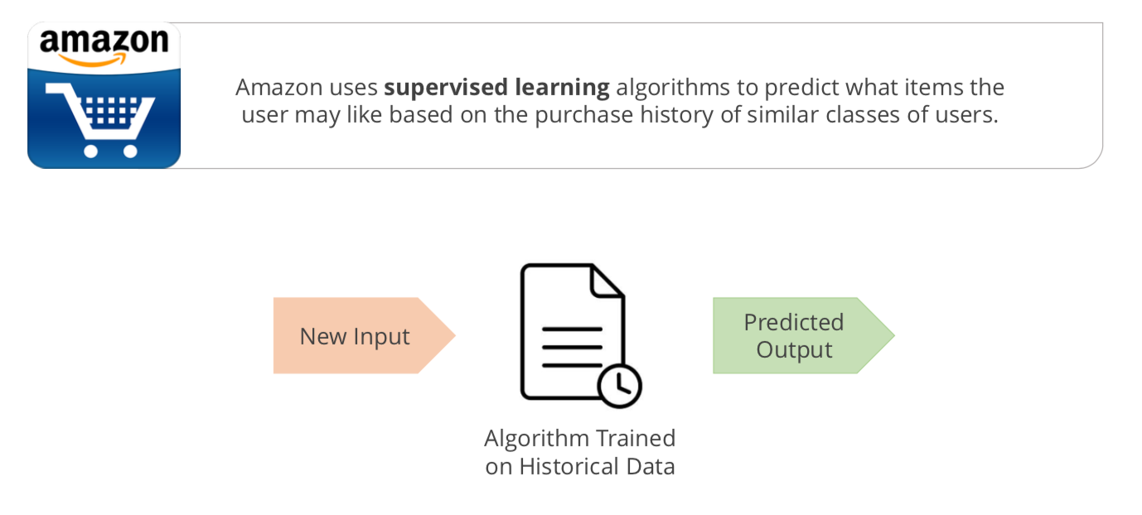
Supervised Learning (Case Study) & Definition:
Supervised Learning is a type of Machine Learning used to learn models from labeled training data. It allows us to predict output for future or unseen data.

Slide 10
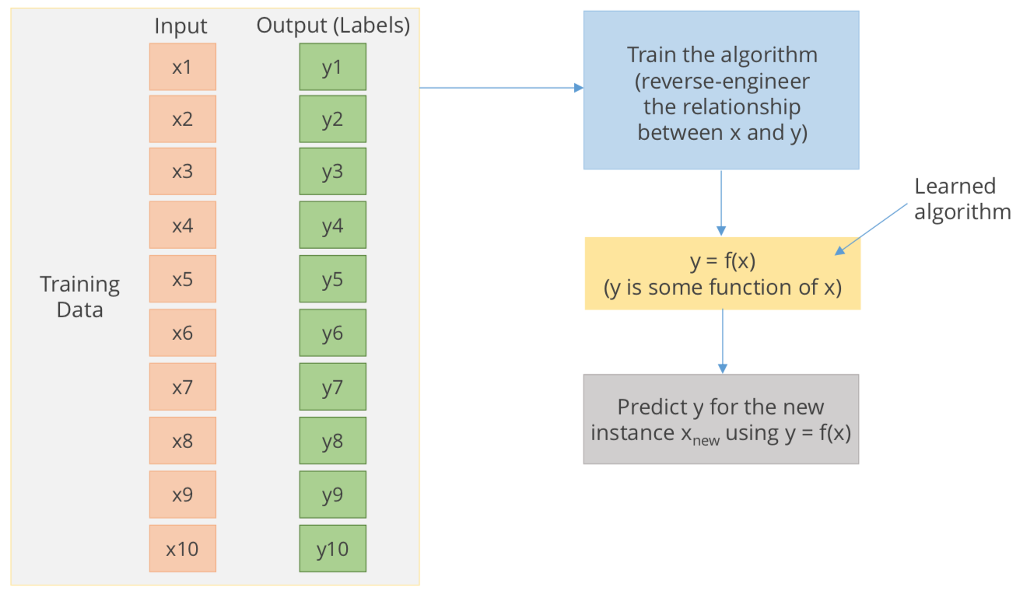
Understanding the algorithm:

Slide 11
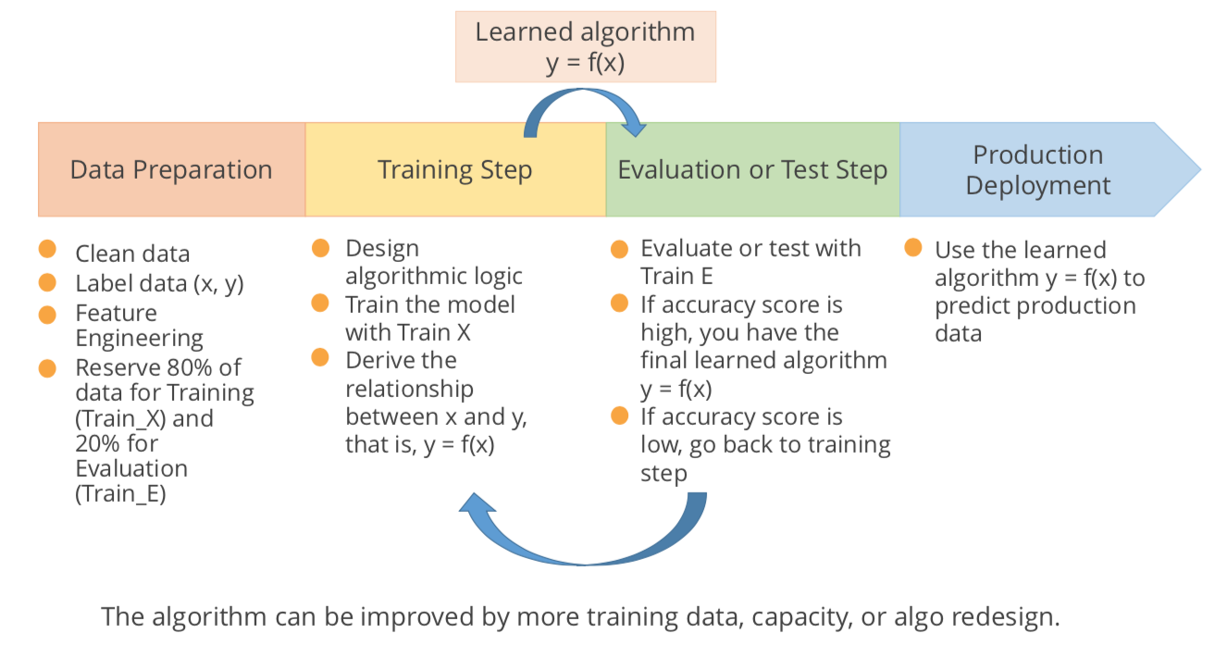
Supervised Learning Flow:

Slide 12
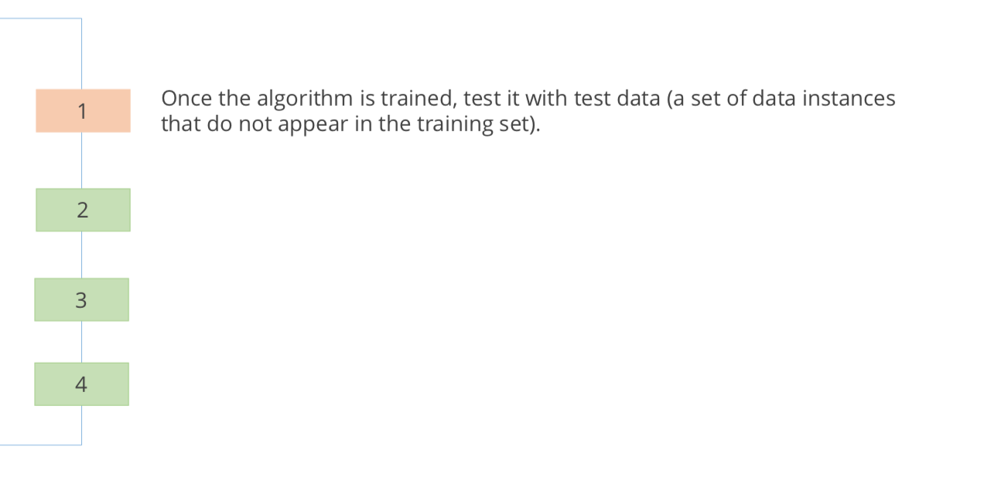
Testing the Algorithm:

Slide 13
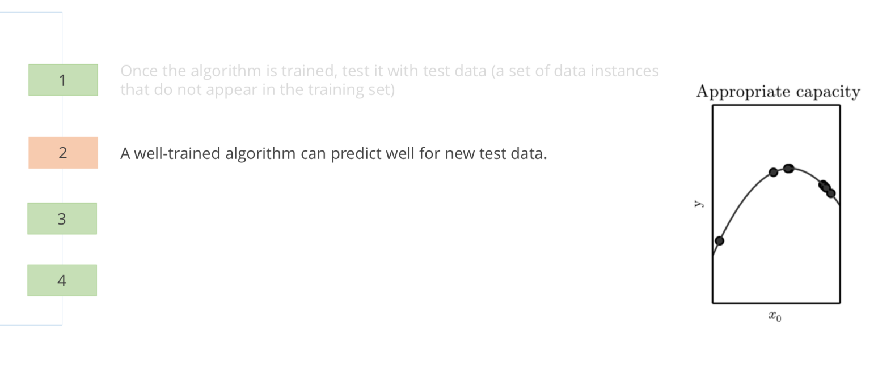
Testing the Algorithm:

Slide 14
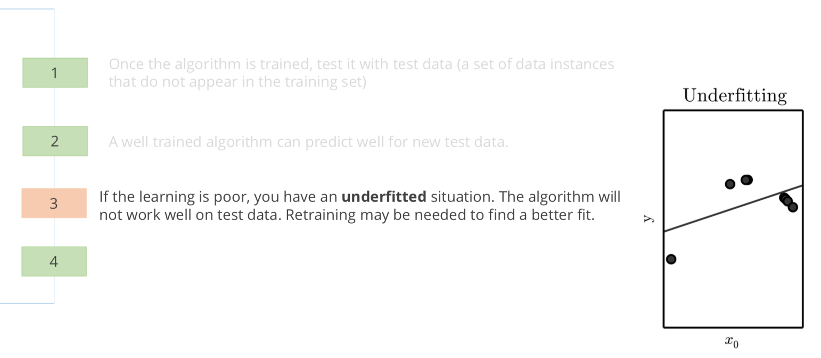
Testing the Algorithm:

Slide 15
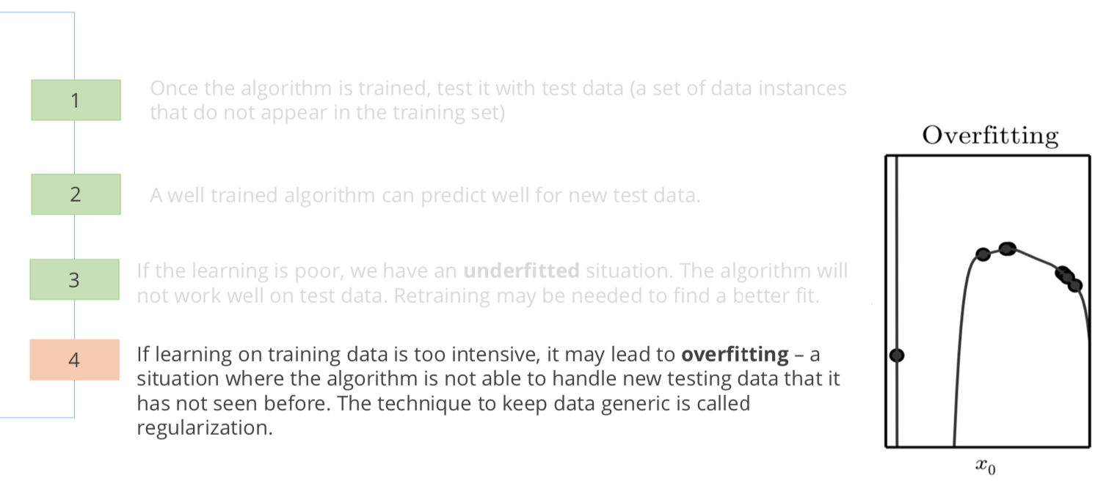
Testing the Algorithm:

Slide 16

Examples of Supervised Learning:

Slide 17
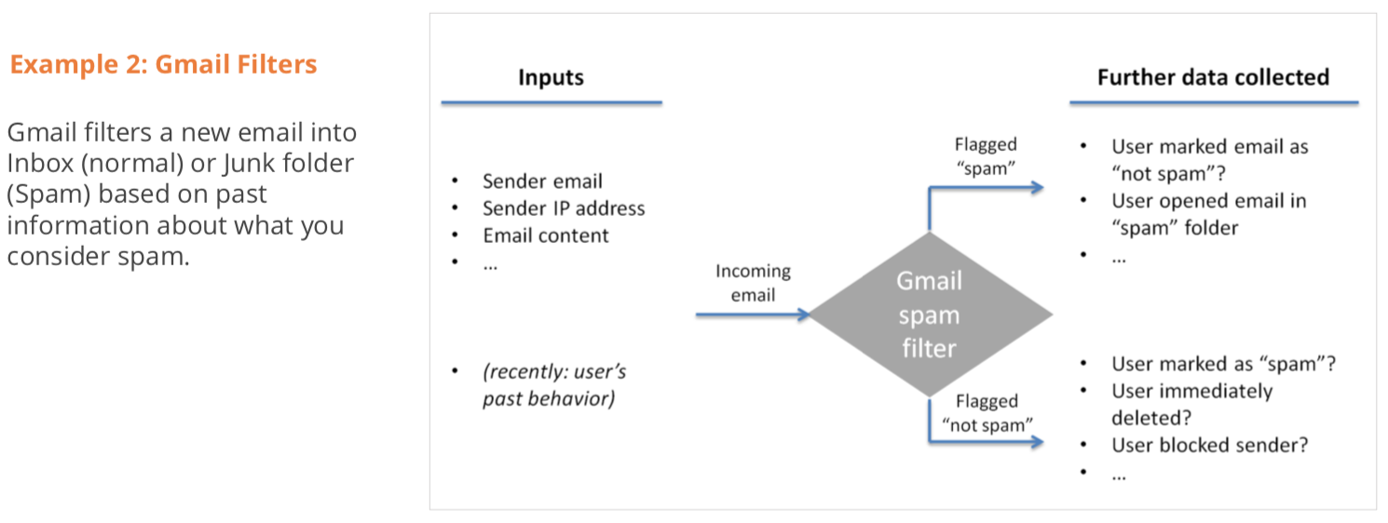
Examples of Supervised Learning:

Slide 18
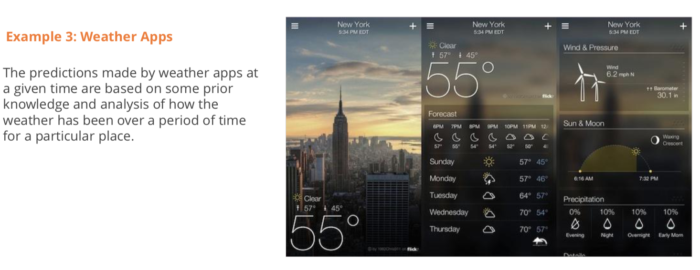
Examples of Supervised Learning:

Slide 19
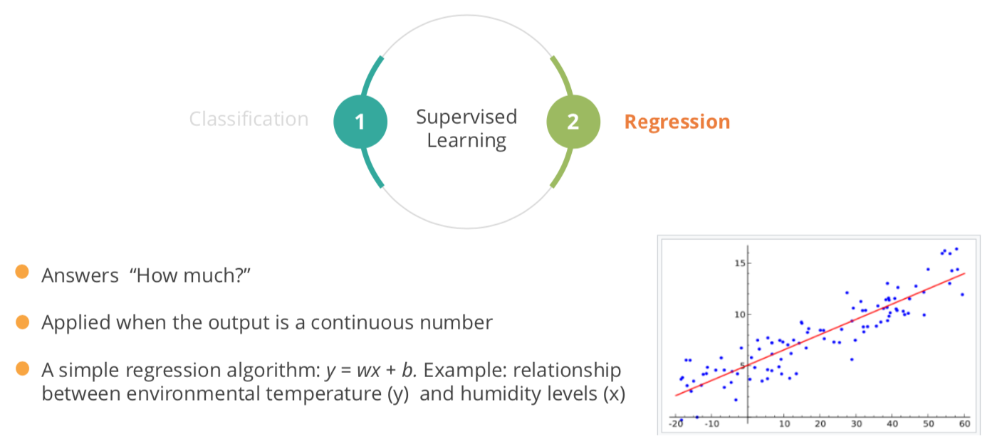
Types of Supervised Learning (Regression):

Slide 20
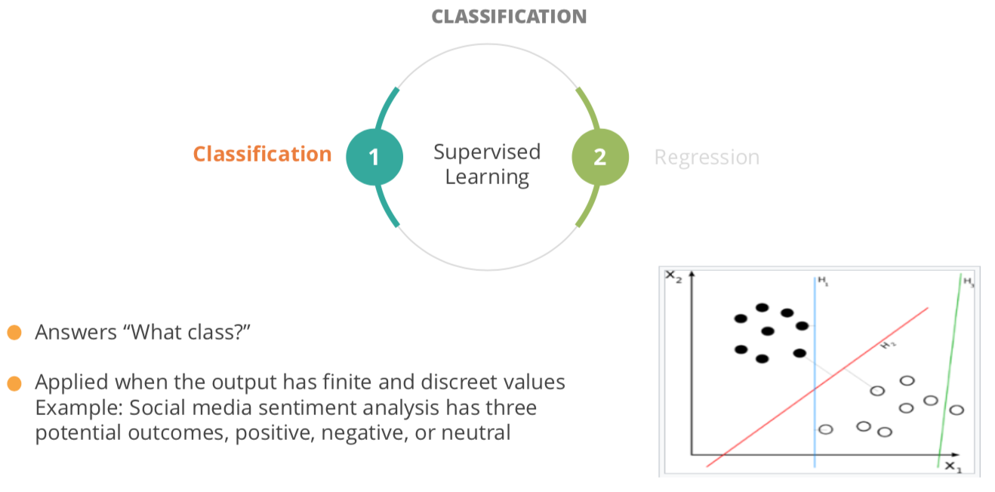
Types of Supervised Learning (Classification):

Slide 21
Linear Regression

Slide 22
Linear Regression Models:
The term "regression" generally refers to predicting a real number. However, it can also be used for classification (predicting a category or class.)
The term "linear" in the name “linear regression” refers to the fact that the method models data with linear combination of the explanatory variables.
A linear combination is an expression where one or more variables are scaled by a constant factor and added together.
In the case of linear regression with a single explanatory variable, the linear combination used in linear regression can be expressed as:
response = intercept + constant ∗ explanatory
In its most basic form fits a straight line to the response variable. The model is designed to fit a line that minimizes the squared differences (also called errors or residuals.).

Slide 23
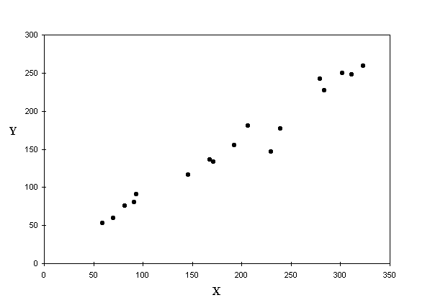
Linear Regression Models:
Given Y = f(x) and the scatter plot shows apparent correlation between X and Y Let’s fit a line into the scatter which shall be our model
But there are infinite number of lines that can be fit in the scatter. Which one should we consider as the model?

Slide 24
Linear Regression Models (Recap):
Whichever line we consider as the model, it will not pass through all the points.
The distance between a point and the line (drop a line vertically (shown in yellow)) is the error in prediction
That line which gives least sum of squared errors is considered as the best line
Error = (T – (mx + C)
Sum of all errors can cancel out and give 0
We square all the errors and sum it up. That line which gives us least sum of squared errors is the best fit

Slide 25
Linear Regression Model:
Advantages –
Simple to implement and easier to interpret the outputs coefficients
Disadvantages -
Assumes a linear relationships between dependent and independent variables. That is, it assumes there is a straight-line relationship between them
Outliers can have huge effects on the regression
Linear regression assumes that the data are independent
Linear regression looks at a relationship between the mean of the dependent variable and the independent variables.
Just as the mean is not a complete description of a single variable, linear regression is not a complete description of relationships among variables
Boundaries are linear

Slide 26
Logistic Regression

Slide 27
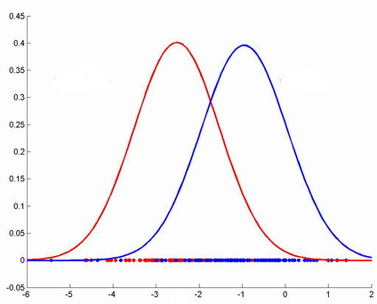
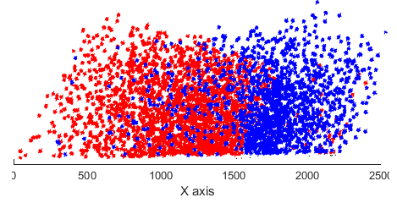
Logistic Regression Model -
A classification method built on the same concept as linear regression. The response variable is categorical. In it’s simplest form, the response variable is binary i.e. belongs to one class or the other
Given the value of predictor (variable x), the model estimates the probability with the new data point belongs to a given class say “A”. Probability values can range between 0 and 1.
Class B
Class A
Class B
Class A

Slide 28
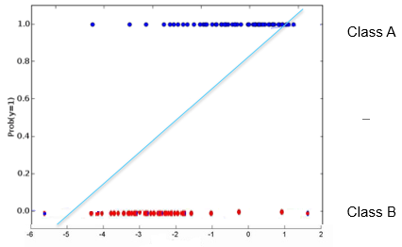
Logistic Regression Model
A classification method built on the same concept as linear regression. The response variable is categorical. In it’s simplest form, the response variable is binary i.e. belongs to one class or the other
Given the value of predictor (variable x), the model estimates the probability with the new data point belongs to a class. If we try to fit a linear model (t) into the data, for extreme values of x, the probability would go beyond 1 or beyond 0 which is meaningless
Probabillity model

Slide 29
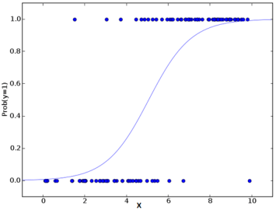
Logistic Regression Model:
The linear model is passed to a logistic function p = 1/ 1 + e^-t the result of which is values between 0 and 1 and hence good representation of probability
Class A
Class B
Note: The model t (which is of the form mx + c), represents logit which is natural log(p / 1-p) where p is probability that a data point belongs to a class or not

Slide 30
Logistic Regression Model -
Advantages -
Makes no assumptions about distributions of classes in feature space
Easily extended to multiple classes (multinomial regression)
Natural probabilistic view of class predictions Natural probabilistic view of class predictions
Quick to train
Very fast at classifying unknown records
Good accuracy for many simple data sets
Resistant to overfitting
Can interpret model coefficients as indicators of feature importance
Disadvantages -
Constructs linear boundaries

